Slide 1

Site Organization and Navigation
A Regional University Transcending Boundaries

Slide 2
Site Types
A static website
A static website is one that has web pages stored on the server in the format that is sent to a client web browser.
It is primarily coded in Hypertext Markup Language, HTML.
Simple forms or marketing examples of websites, such as classic website, a five-page website or a brochure website are often static websites, because they present pre-defined, static information to the user. This may include information about a company and its products and services via text, photos, animations, audio/video and interactive menus and navigation.

Slide 3
Site Types…
Dynamic website
A dynamic website is one that changes or customizes itself frequently and automatically, based on certain criteria.
Dynamic websites can have two types of dynamic activity: Code and Content. Dynamic code is invisible or behind the scenes and dynamic content is visible or fully displayed.

Slide 4
Site Types…
Affiliate
A site, typically few in pages, whose purpose is to sell a third party's product. The seller receives a commission for facilitating the sale.

Slide 5
Site Types…
Blog
Sites generally used to post online diaries which may include discussion forums (e.g., blogger, Xanga). Many bloggers use blogs like an editorial section of a newspaper to express their ideas on anything ranging from politics to religion to video games to parenting, along with anything in between. Some bloggers are professional bloggers and they are paid to blog about a certain subject, and they are usually found on news sites.

Slide 6
Site Types…
News Site
Similar to an information site, but dedicated to dispensing news, politics, and commentary.
Information Site
Most websites could fit in this type of website to some extent many of them are not necessarily for commercial purposes

Slide 7
Site Types…
Search engine Site
A website that indexes material on the internet or an intranet (and lately on traditional media such as books and newspapers)and provides links to information as a response to a query.
School Site
A site on which teachers, students, or administrators can post information about current events at or involving their school.

Slide 8
Site Types…
Archive Site
Used to preserve valuable electronic content threatened with extinction. Two examples are: Internet Archive, which since 1996 has preserved billions of old (and new) web pages; and Google Groups, which in early 2005 was archiving over 845,000,000 messages posted to Usenet news/discussion groups.

Slide 9
Site Types…
Photo Sharing Websites
These types of website are cropping up like fleas on dog. There are web companies like, Flickr.com, Photosite.com, and Google's Picasa. There could easily be over a hundred such sites that offer free photo sharing paid for by their online advertising. Also, many digital cameras and photo printers now come with software enabling mere mortals to create digital photo slide shows and upload them to the web.

Slide 10
Site Types…
Online Business Brochure / Catalog Website
In the days before the Internet, we used the print, radio, and television media to spread the word about our businesses. Now we can cast a large net, reaching literally millions of people with just one website. With your online brochure or catalog, you can show anyone who looks for and finds your website, photos and descriptions of your products or services. To some this may sound like an Ecommerce Website, but there are many businesses that deal in products or services that are not sellable over the web—think hair-stylist, dentist, or day-care center

Slide 11
Site Types…
Blogging Website
People took the words Web Logs and shortened it to Blogs —online diaries, journals, or editorials, if you will. My, how Blogs have taken over the Internet. A person used to be outdated if he/she did not have a website, now having a blog is de rigeur . A blog owner will log-on daily, weekly, or whenever, and write about whatever is going on in their lives or business, or they may comment on politics and news

Slide 12
Site Types…
Content Aggregator
Business that gathers and organizes web content and then distributes or feeds the content to subscribers for free or for a fee

Slide 13
Information Architecture
Information Architecture is the first step of the Design Process and is concerned with the organization and structure of web content.
The Information Architecture for any given site can typically be illustrated in the form of a tree diagram, as shown in the next slide.

Slide 14
A simple Information Architecture.
Notes:
A diagram like this is useful for demonstrating the extent of content to be placed online.
The illustration also shows how content is inter-related.

Slide 15
Information Architecture…
The process for creating an Information Architecture is relatively straightforward.
It simply requires every item within a Content Inventory (a catalogue of everything to be published on a website) to be organised into groups, based on characteristics that are meaningful to the target audience.

Slide 16
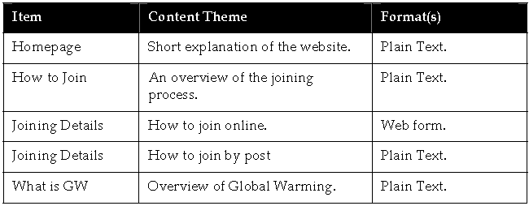
A sample website content inventory

Slide 17
Creating the Information Architecture
A usability technique called Card Sorting provides a useful way to achieve .
Card sorting works by using all the items in a Content Inventory as building blocks within a site structure. To decide on the correct place for each block, representatives of the website audience are invited to participate in a workshop.
At the workshop customers are presented with a series of cards, each of which has the title of a piece of content on it. They are then asked to sort the cards into clusters (and into a hierarchy) based on how they think the site should be organised.
Some schemes that commonly emerge from such an exercise include; Audience based Architecture, Topic based Architecture, and Task based Architecture.

Slide 18
Creating the Information Architecture …
Audience-based Architecture
An audience-based architecture is appropriate when distinct visitor groups have widely different needs. This can arise due to geographic, language or business affiliations. For example, on www.dell.com content is clustered into groups based on industry types, e.g. Government, Education & Healthcare, Large & Medium Sized Business, etc.

Slide 19
Creating the Information Architecture …
Topic-based Architecture
This is the most popular means for structuring content on the World Wide Web. In this case, content is grouped into clusters based on the subject matter of the website itself. For example, the sports equipment manufacturer Wilson (www.wilson.com) organises its content according to sporting interest, e.g. tennis, golf, etc.

Slide 20
Creating the Information Architecture …
Task-based Architecture
A task-based architecture is suitable for websites whose main purpose is to deliver applications, i.e. to allow customers to ‘do’ something. Many online banks and intranets are structured in this way, e.g. ‘View my account’, ‘Submit expenses', etc

Slide 21
Creating the Information Architecture …
When the Architecture has been completed, it can then be reproduced as a tree diagram (perhaps using a drawing tool such as Visio).
The tree diagram allows a site structure to be seen at a glance and the relationship between content elements to be understood.

Slide 22
Navigation
Navigation Design has always been at the heart of the World Wide Web. This is because the power of the internet lies in its ability to connect disparate information through hyperlinks.
Navigation is primarily concerned with the selection of suitable systems of wayfinding.
Wayfinding is defined as "the process used to orient and navigate. The overall goal of wayfinding is to accurately relocate from one place to another in a large-scale space".

Slide 23
Navigation..
The most important concerns when designing such a system are to ensure that website visitors always know the answer to each of the following questions:
Where am I ?
How did I get here ?
How can I return to where I came from ?
Where can I go from here ?
A significant amount of research has been carried out in this area, from which have emerged a number of widely used systems. Among these are: (Global Navigation, Local Navigation, Breadcrumb Navigation, Index/Directory, Contextual Navigation, Search, Sitemap, Drop Down menu, A-Z index, Guided Tour )

Slide 24

Global Navigation
Global Navigation is the primary layer of navigation on a website. Its purpose is to provide access to all major categories within an Information Architecture. The most common means for presenting Global Navigation is horizontally beneath a website’s masthead (as below).

Slide 25
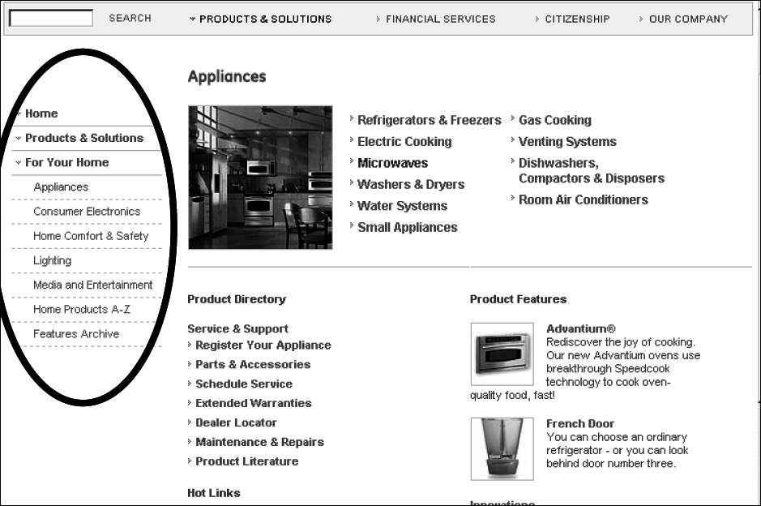
Local Navigation
Local Navigation provides access to content that adjoins or is related to the section of a website currently on view. Secondary navigation normally comes into play after a visitor has selected a category from Global Navigation. The most popular system for Local Navigation is to place it vertically to the left (or right) of a screen

Slide 26
Breadcrumb Navigation
On websites that have a lot of pages, breadcrumb navigation can greatly enhance the way users find their way around.
A “breadcrumb” (or “breadcrumb trail”) is a type of secondary navigation scheme that reveals the user’s location in a website or Web application. they are used for illustrating the location of a visitor within a site's overall structure.
The term comes from the Hansel and Gretel fairy tale in which the two title children drop breadcrumbs to form a trail back to their home. Just like in the tale, breadcrumbs in real-world applications offer users a way to trace the path back to their original landing point.

Slide 27
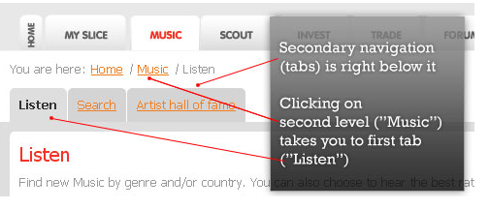
Breadcrumb Navigation

Slide 28
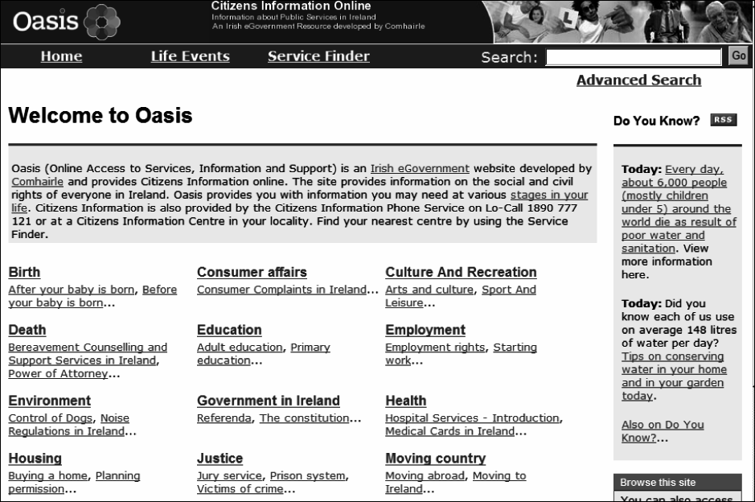
Index / Directory
This system is used on websites that contain a very large number of categories in the first level of Information Architecture, e.g. Oasis Citizens Information at www.oasis.gov.ie.

Slide 29
Contextual Navigation
Contextual Navigation refers to hyperlinks that are embedded in the text of a website. This system allows links to be created anywhere.

Slide 30
Sitemap
A sitemap provides an overview of all elements within the primary and (possibly) secondary layers of content in a site
In short, a site map shows where content lives – typically in an outline form where you can have pages in sections
Here’s a simple site map example:
Home
About Us
Products
Product 1
Product 2
Product 3
Services
Service 1
Service 2
FAQs
Contact Us

Slide 31
Search
Search provides access to all content on a website, via a text entry field. Results are provided based on a match between the search query and site content

Slide 32
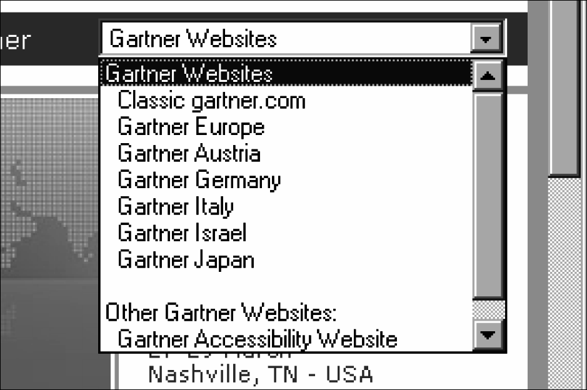
Dropdown menu
A dropdown menu enables direct access to nominated pages within a website, as demonstrated on www.gartner.com.

Slide 33
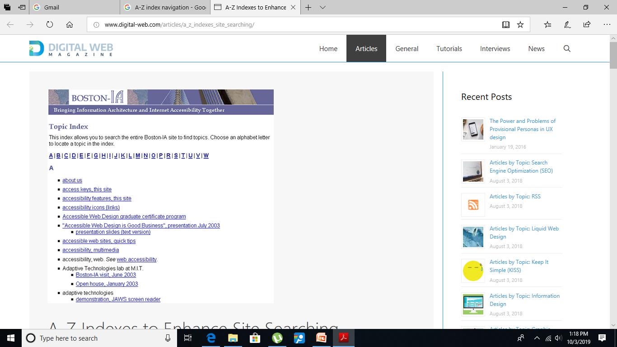
A–Z Index
This system uses an index of content that is organised alphabetically. This is helpful on websites with lots of information and applications.

Slide 34
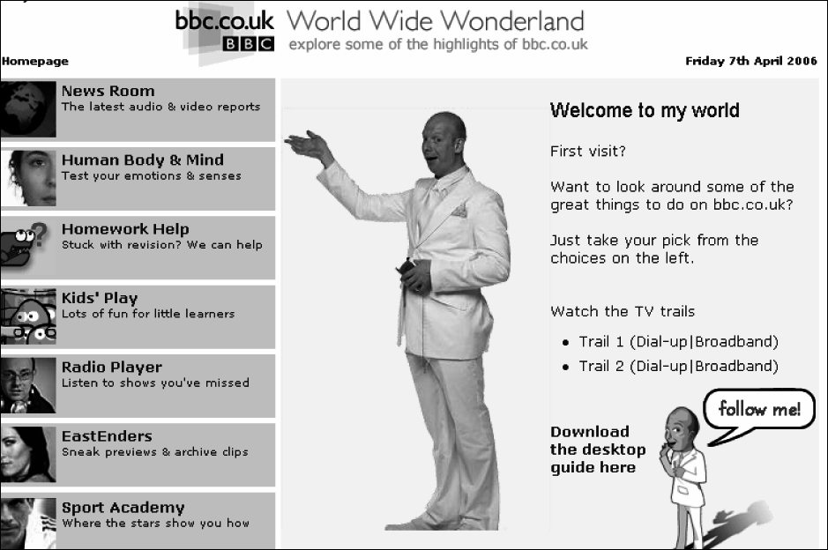
Guided Tour
This is a system that provides an overview of website content to inexperienced or first-time visitors.
Guided tours use a series of steps that may span multiple pages. You can create steps that users read through and acknowledge

Slide 35
Other Systems
Some other navigation systems include:
Bookmarks. Also called ‘My Favourites’ or ‘My Links’, this is a feature that allows a website visitor to save hyperlinks to pages they are most interested in.
History List. This feature automatically saves a list of the top five or six pages that a visitor has accessed.
Hot Links. Hot Links combine the history lists of all visitors to create a record of the most universally popular pages.

Slide 36
Note:
The selection of an appropriate navigation system depends on the volume of content in a website and the detail with which it is organized.
For example, a large website with a detailed Information Architecture (e.g. www.bbc.co.uk) probably requires several systems including Global and Local Navigation, Breadcrumb Trails, a Sitemap, Search, an A–Z Index, as well as a Guided Tour for first-timers.

